Slide 1
Woodland Dwelling Project Submission
Vishal Lowe Period 6

Slide 2
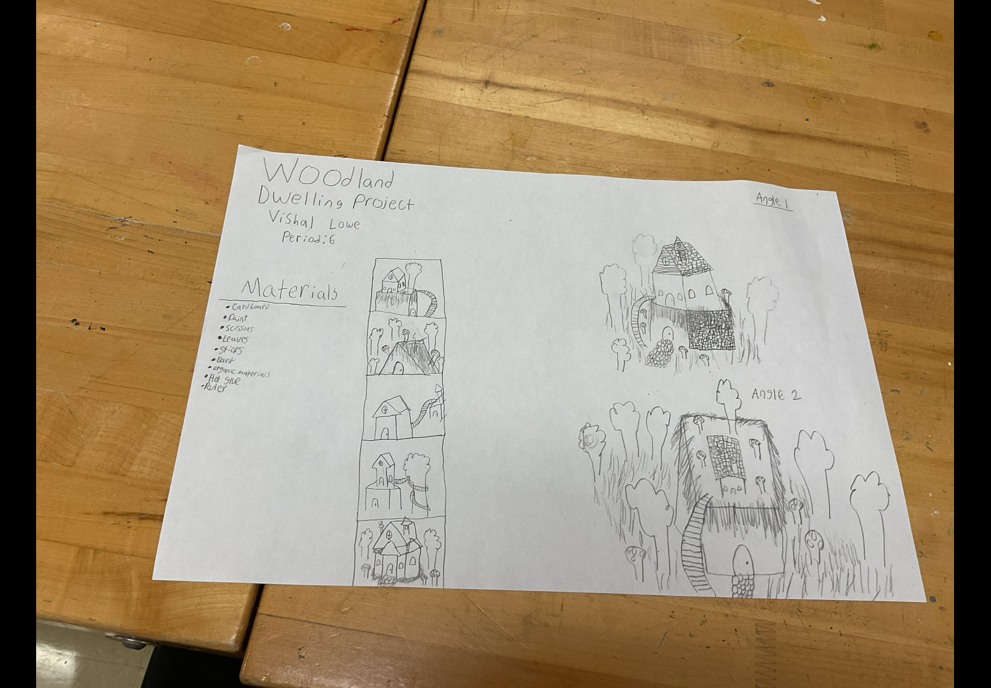
Idea Board planning

Slide 3
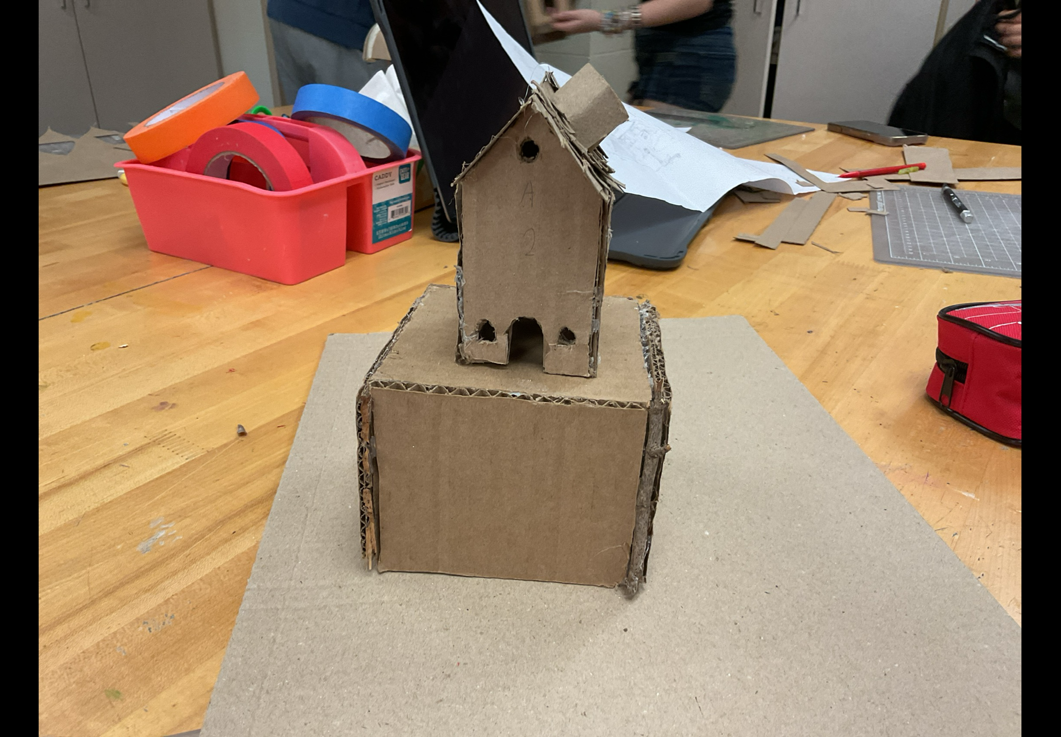
PROCESS PHOTO

Slide 4
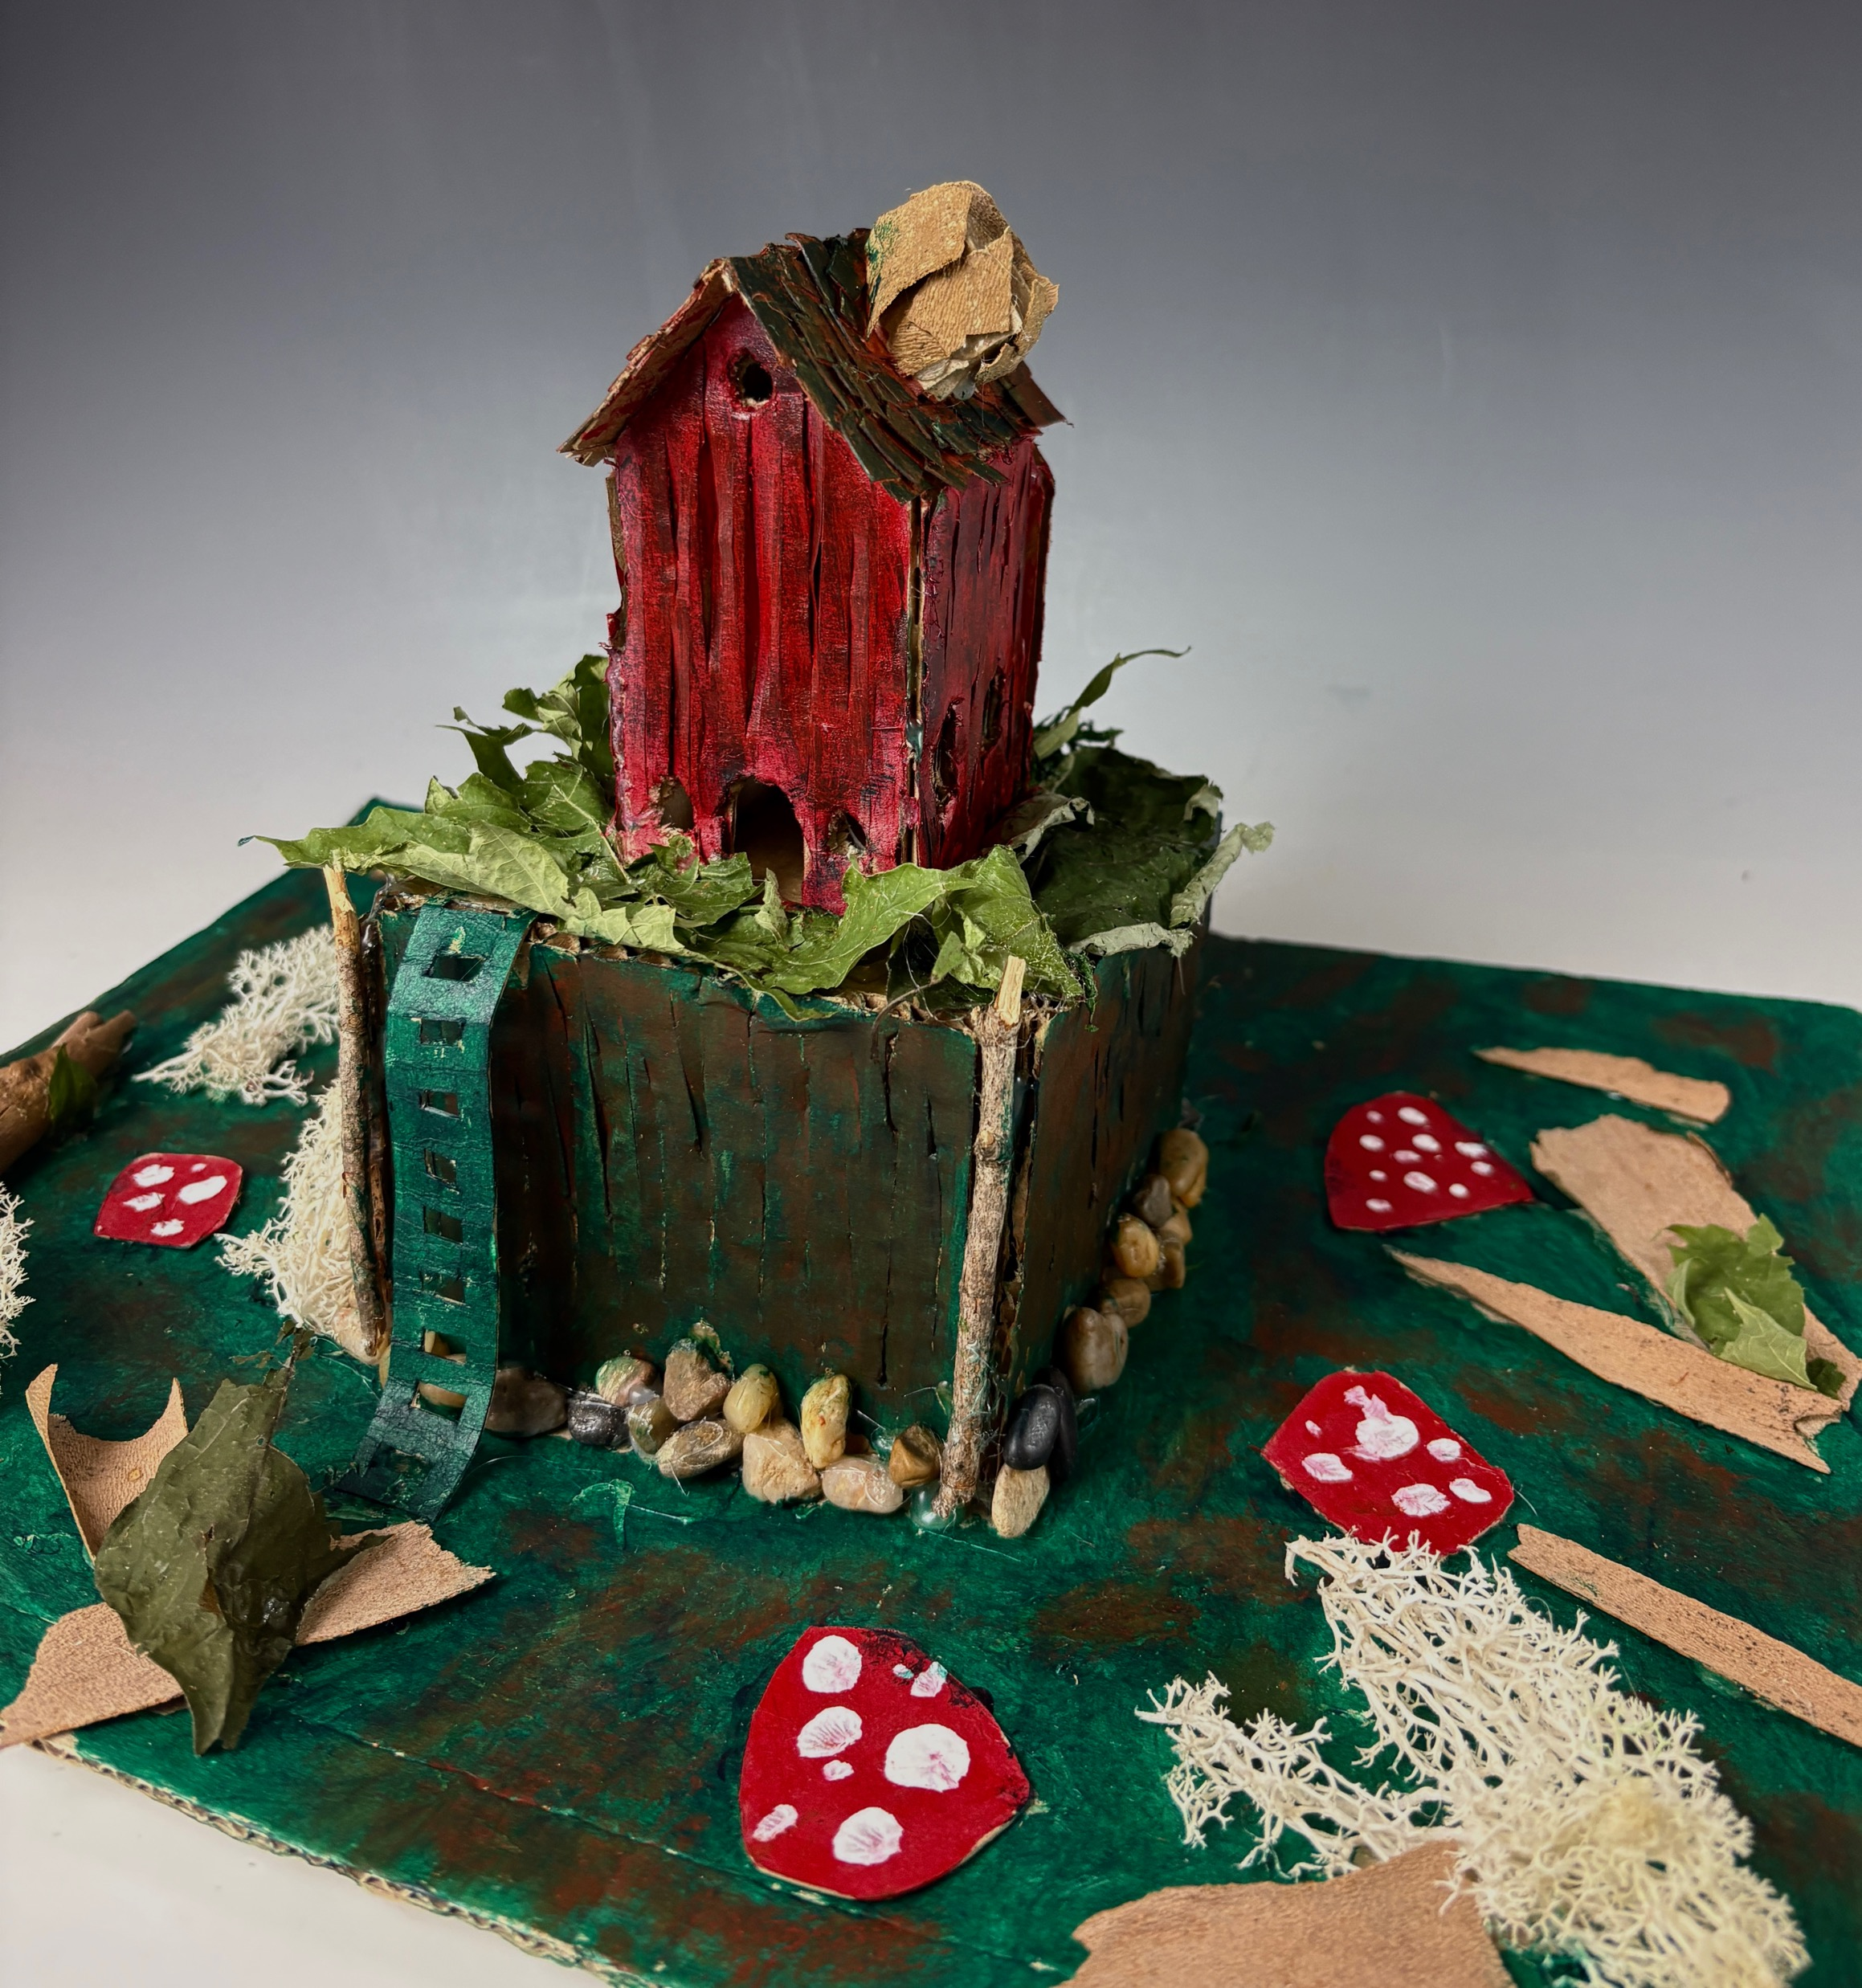
Final angle 1

Slide 5
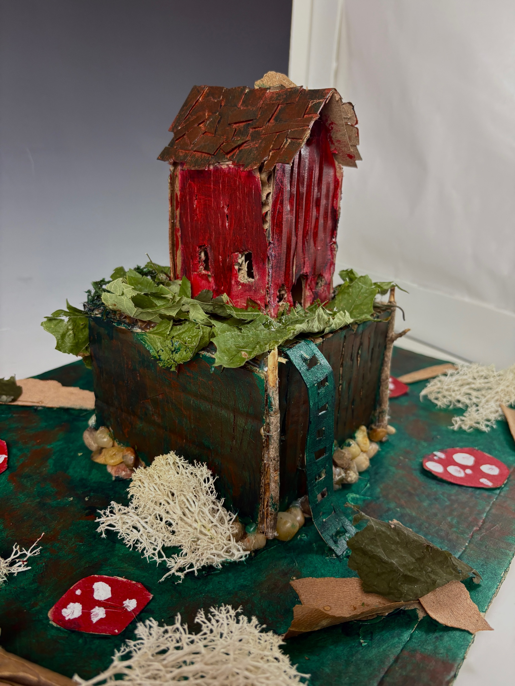
FINAL ANGLE 2

Slide 6
SELF REFLECTION:
___/25 Requirements – Did you meet all of the requirements? (Using 2-3 natural materials, entirebuild fits in your locker, at least 2 windows and 1 door, used multiple techniques for connections anddesign, & sketched at least 2 different views).
___/25 Craftsmanship - Rate how well you did with focusing on craftsmanship for this project. Can you see any connections, painting mistakes, etc?
___/25 Creativity and Material Exploration – Rate how creative you think your overall build went. Did you challenge yourself? Did you use a range of materials?
___/25 Effort and Time Management - Did you use your in-class and out of class time wisely? Did you utilize TI time when necessary, did you waste time by not working, etc.?
___/25 Texture, Color, Layering, and Connection – How well did you consider these elements, principles, and techniques during the creation of your dwelling? Are all four of these obvious highlights in your build?

Slide 7
SELF REFLECTION CONTINUED:
Explain why you gave yourself the grade you did.
Requirements: [I think i would give myself a 24/25 because I did everything but I feel like I could've made a door and made more detailed windows]
Craftsmanship: [24/25, I did well in construction and building on time but theres a couple spots that could’ve been made better]
Creativity and Material Exploration:[25/25, I used a lot of materials to help with my look and I did good at using them]
Effort and Time Management:[25/25, I used my time well and I was finished with my project within a good amount of time and I didn’t finish it late]
Texture, Color, Layering, and Connection:[24/25, I used good texture and materials to help build up my project and also I used different painting techniques to try and make my project more interesting ]
What environment or culture did you base your build on?
[I based it off a house that you could find in the woods and I wanted it to be a little shack on top of a hill]
Is there anything you would change about this project? Also, add any additional comments here.
[I would want to add more to the environment and build the hill better]

